Slide 1
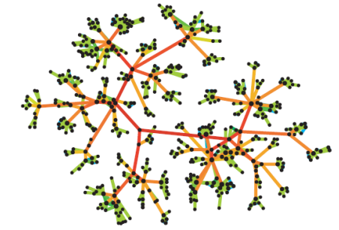
DSAI4205 Big Data Analytics
Assignment 3 Additional slides

Slide 2
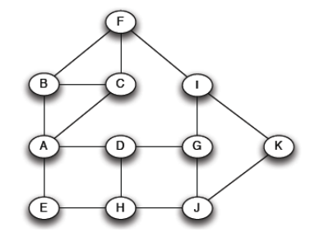
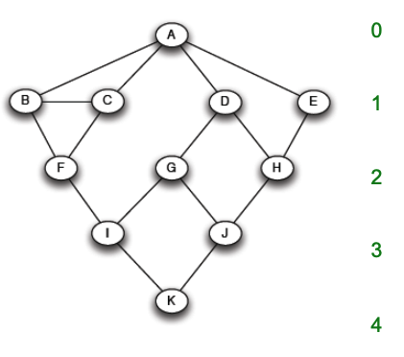
How to compute Edge Betweenness ?
Want to compute betweenness of paths starting at node !
Breadth first search starting from A:

Slide 3
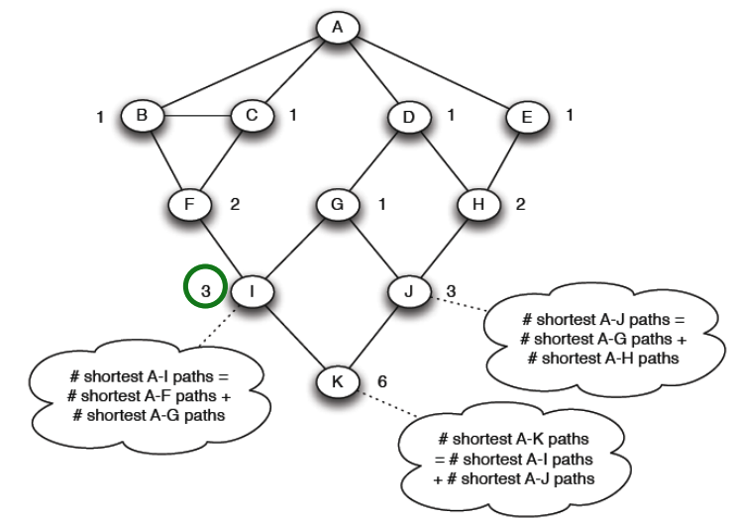

How to compute Edge Betweenness ?
Forward step: Count the number of shortest paths $σ_{A_{i}}$ from A to all other nodes $i$ of the network

Slide 4
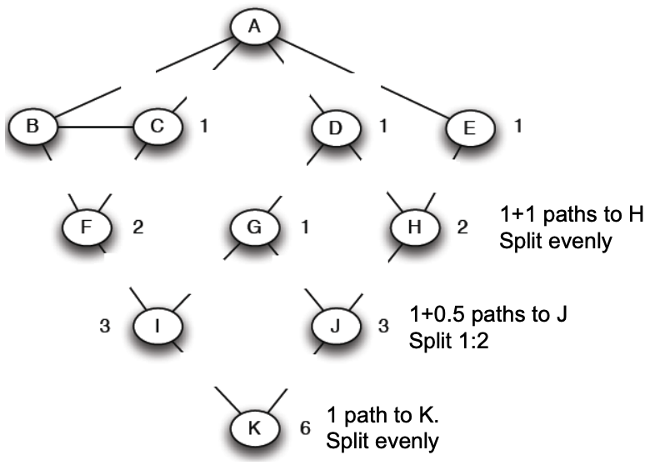
How to compute Edge Betweenness ?
Backward step: Compute betweenness: If there are multiple paths count them fractionally
Algorithm:
Add edge flows:
node flow = 1+∑child edges
split the flow up based on the parent value
Repeat the BFS procedure for each starting node !
Sum up all of the edge betweenness we compute in each graph and divide by 2, and the result is the edge betweenness of edges.
2
4
2
2
1
1
2
1
1
1
0.5
0.5
1
0.5
0.5

